Slide 1
Esther Imagined,
Esther Illustrated
Part 1:
The ancient בית כנסת
in Dura Europos

Slide 2
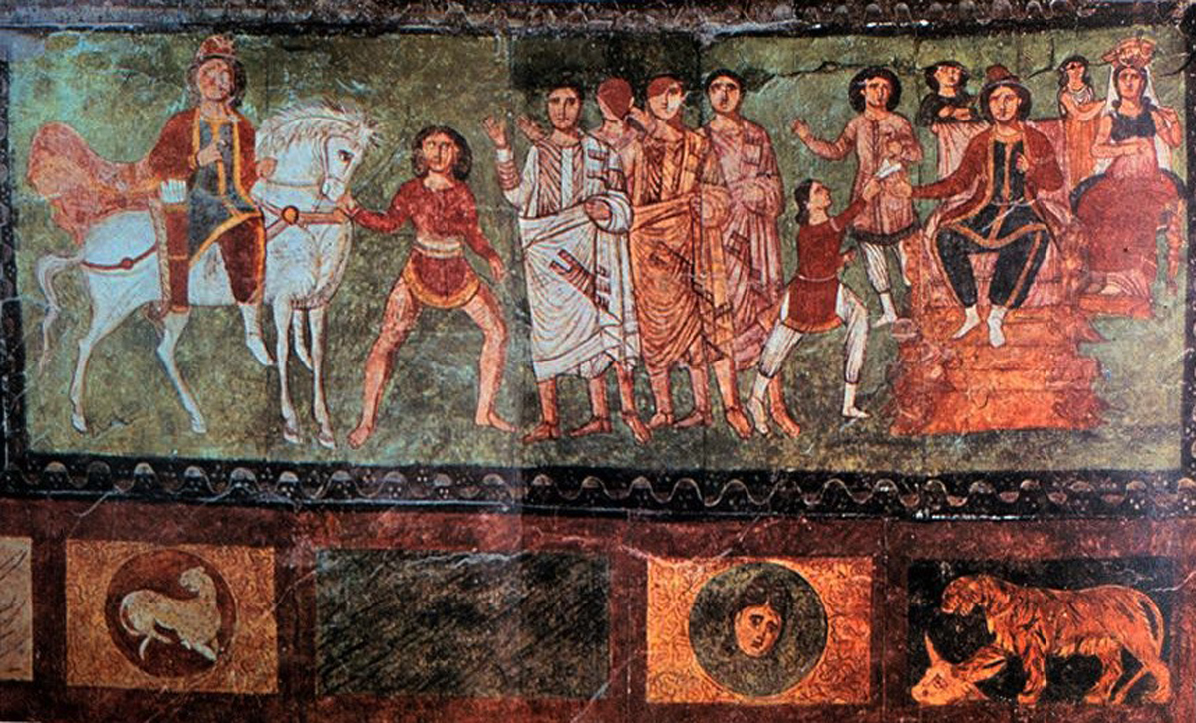

Slide 3
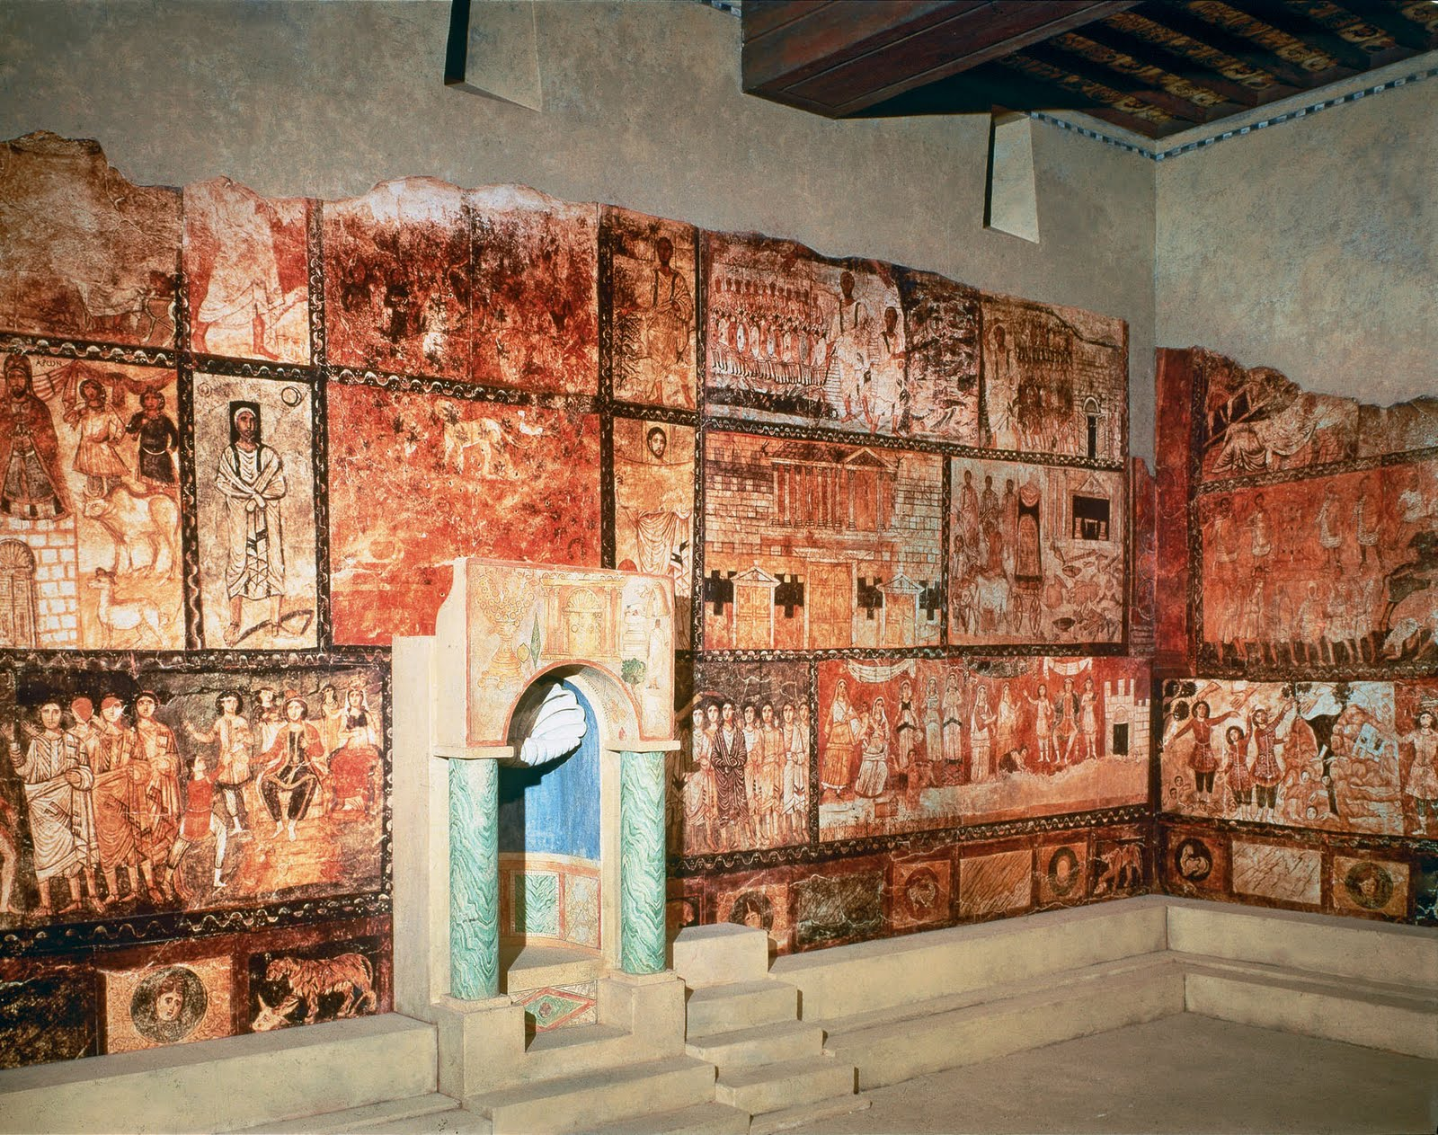

Slide 4
Part 2:
Seventeenth Century Europe –
Rembrandt and Gelder,
Illustrated Megillot

Slide 5
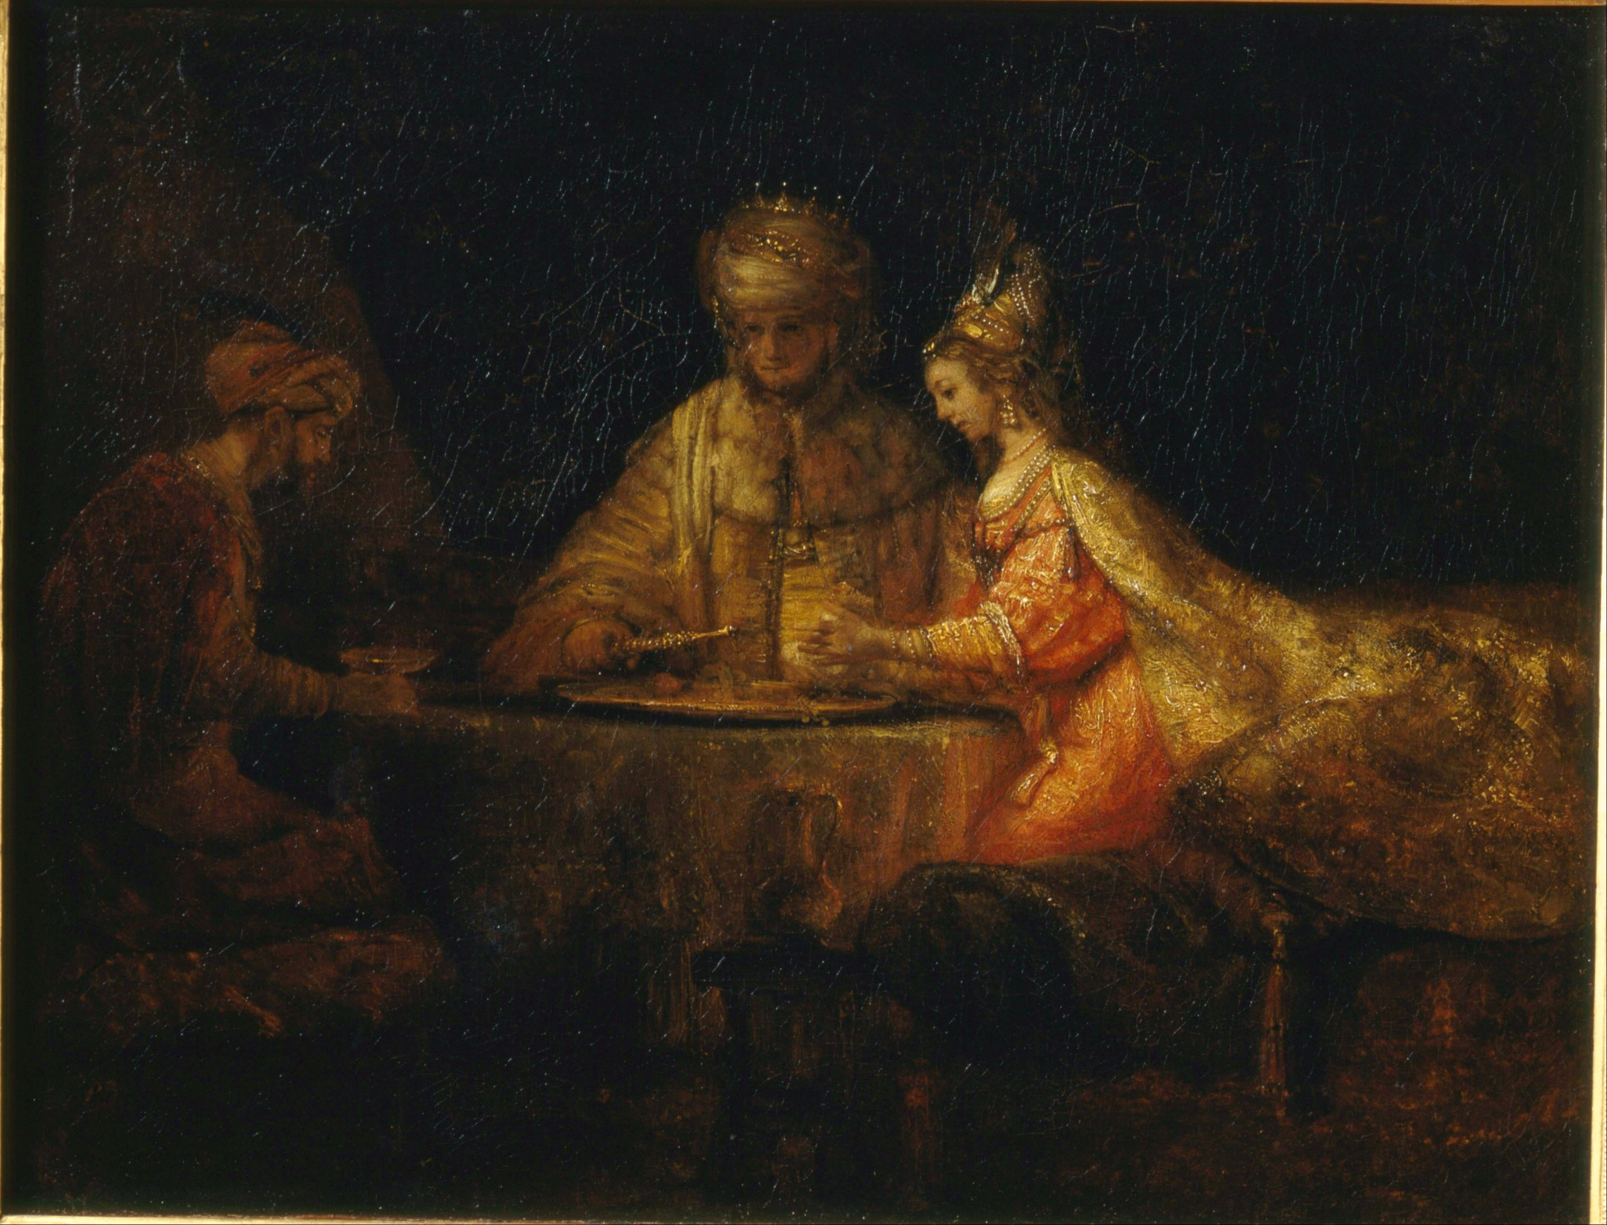

Slide 6
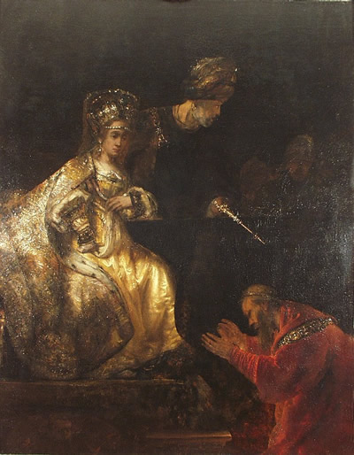

Slide 7
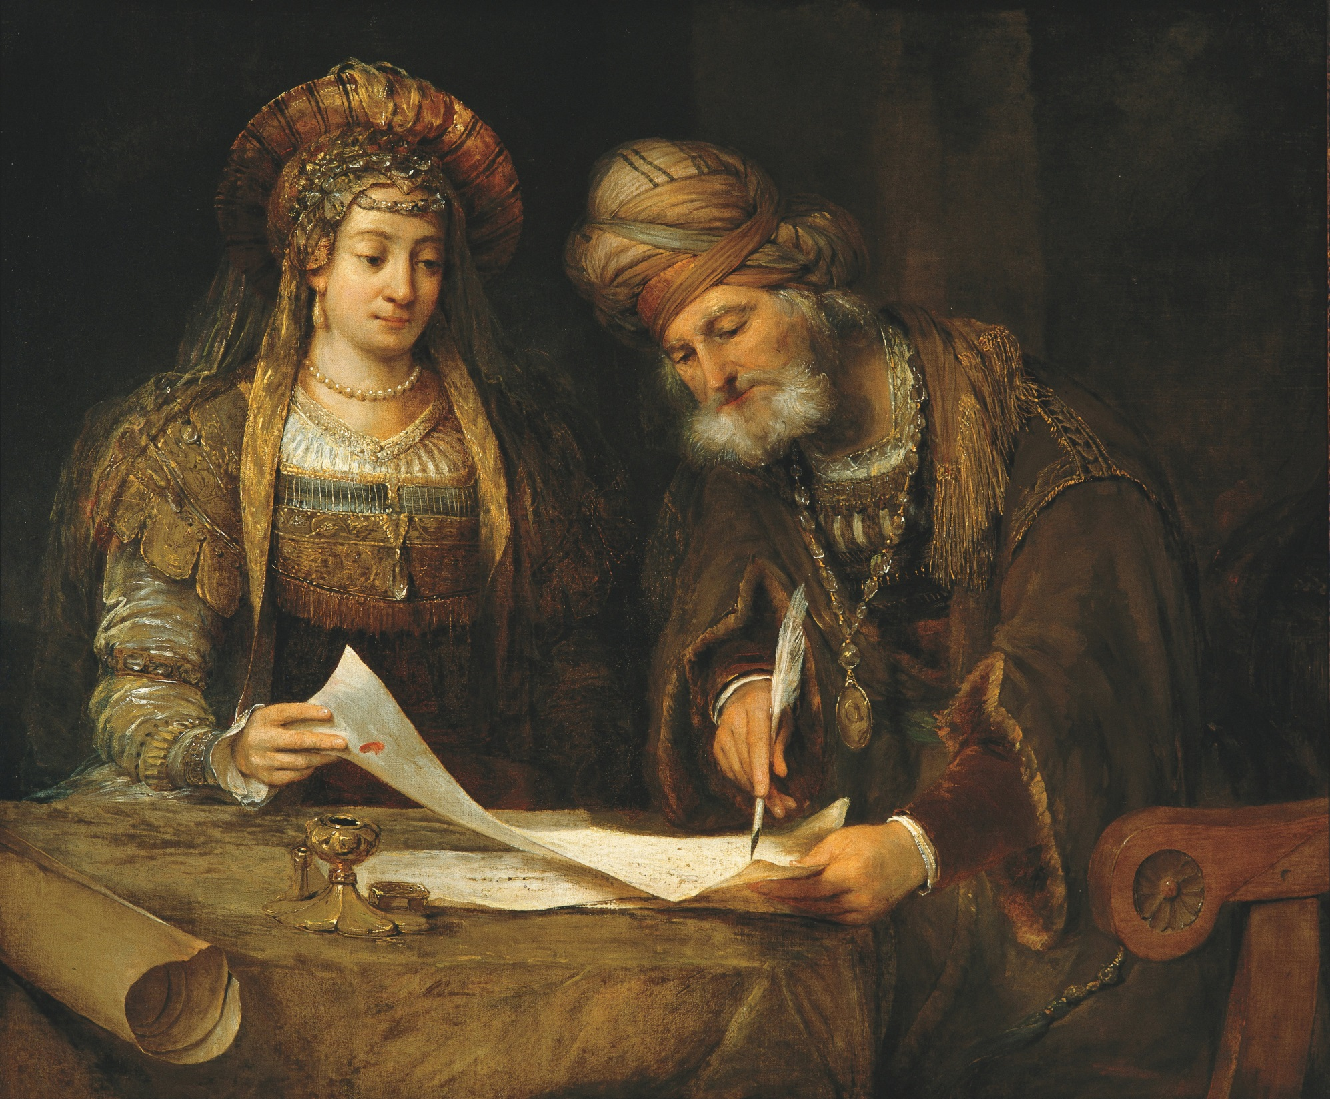

Slide 8
17th Century Italy: The first illustrated Megillot

Slide 9
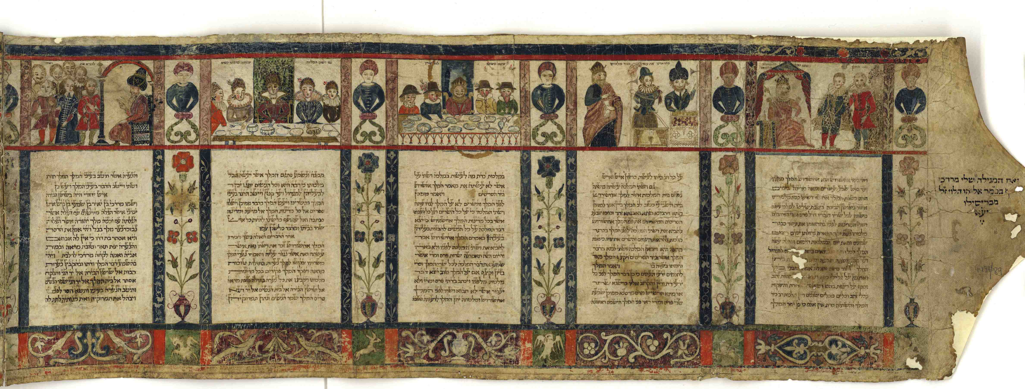
The earliest known illustrated Esther: Ferrara, 1616
Written and illustrated by Moshe ben Avraham Peshkarol
In the collections of the National Library in Jerusalem

Slide 10
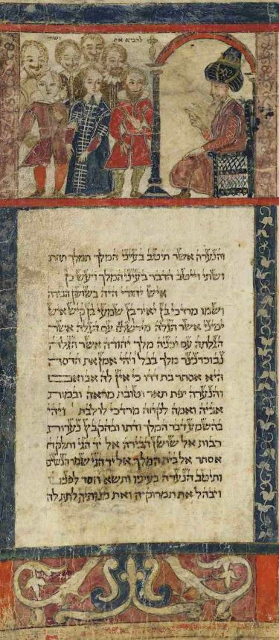

Slide 11
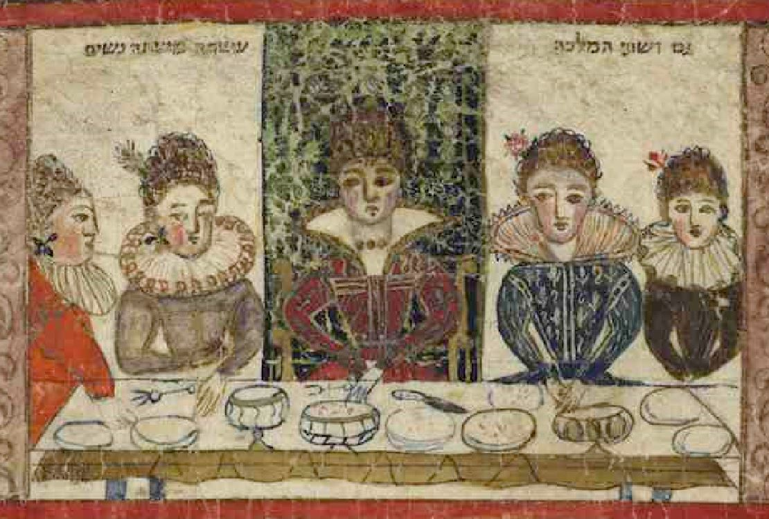

Slide 12
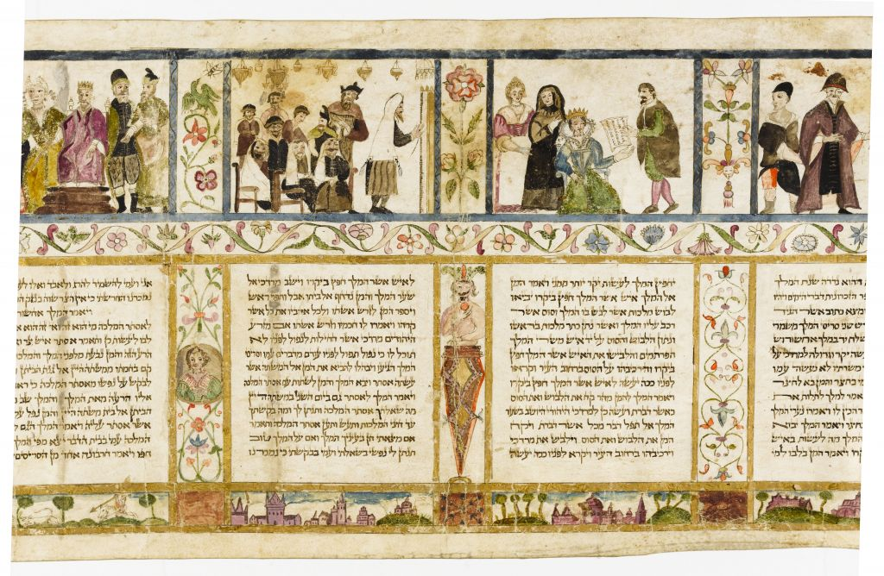
Another Megillat Esther from early 17th century Italy in the same style

Slide 13
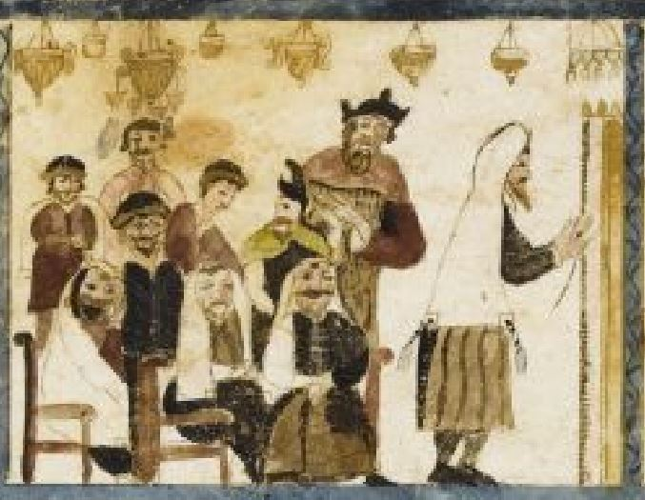
What scene is illustrated here?
Where in the Megilla would you place this?
What do you notice about the dress of the people and the appearance of the בית כנסת?

